Slide 1

Keys to Leading Millennials

Slide 2
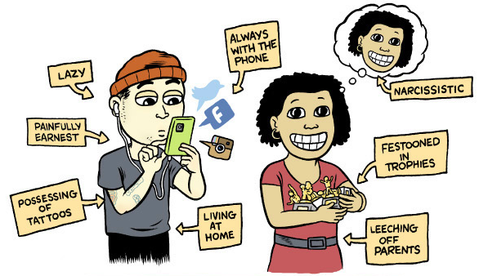
Who Are Millennials?

Slide 3

Baby Boomer Issues

Slide 4
Generational Breakdown
Baby Boomers
Gen Xers
Millennials
Gen Z, Gen iY
(1947-1964) 53-70 years
(1965-1977) 40-52 years
(1978-1999) 18-39 years
(2000-Present) under 18

Slide 5
Millennial Generation
Best informed
Most mobile
Best protected
Most focused

Slide 6
Millennial Challenges
Young adults make an average of $40,581 per year
  20% less than their parents did
  (Young Invincibles, 2017)
Average college graduate will have $37,112 in college debt
  200% more than their parents
  (fool.com, 2016)
32% of millennials (18-34) still live with their parents
  73% of parents age 40-59 have helped support an adult child
  Median age of a homebuyer is 33 years old
  (Pew research, 2014)

Slide 7
Workforce Changes
By 2020, millennials will make up 50% of workforce
By 2025, millennials will make up 75% of workforce
In 2020, first time 4 generations will be in the workforce
Until 2030, every day 10,000 Baby Boomers will turn 65

Slide 8
Workforce Approaches
71% want co-workers to be like family
34% want to work for a company with less than 100 employees
72% would like to be their own boss someday
34% feel ongoing coaching and feedback demonstrates employer commitment

Slide 9
Managing Millennials
Balance
  Personal and professional life
Engagement
  Communicate frequently
  Be approachable, authentic, and team-focused
Feedback
  No feedback is bad feedback
Personal Responsibility
  Be a mentor, not a boss
  Do not micromanage
Purpose
  Share the strategic goal of projects
  Must inspire

Slide 10
Action Steps to Lead
Give opportunities to participate immediately
Involve in decision making
Allow participation in meetings, discussions, and planning

Slide 11
Millennial Leaders
Communicate often and well
Find effective solutions
  Not necessarily fastest or easiest
Seek differing perspectives
Strong results orientation
Support and inspire others authentically

Slide 12
Group Project 1
According to a comprehensive workplace happiness study of more than 12,000 workers by Robert Half, the top drivers of employee satisfaction are having pride in their organizations, feeling appreciated and being treated with fairness and respect.
How can the company you work for improve engagement and happiness for their employees?

Slide 13
Group Project 2
One of the issues that face the electrical contracting industry is the problem of electricians moving from one contractor to another. Many times it’s the type of work offered or the length of a particular project. Other times there are financial implications such as overtime and per diem benefits.
What kind of strategy would help limit this trend in the company you work for?

Slide 14
Group Project 3
You are in charge of a large project that has four generations working on the same job. This would present a multitude of challenges.
What are some ideas to limit the conflicts on this project?
How would the ideas change when considering the field personnel?

Slide 15
Group Project 4
You are in charge of a project that is comprised 75% Millennials.
How could you improve the performance of the project?
What idea’s would you recommend to your supervisor regarding the planning and implementation of this project to help motivate and engage this team?

Slide 16
Millennial Summary
Engage them early and often
Take advantage of technical skills
Challenge, coach, and connect with them
Be approachable, authentic, and adaptable

Slide 17
Books and Articles
The 7 Skills of Highly Effective Millennial Leaders by David Grossman
A Baby Boomer’s Guide to Managing Millennials at Work by J. Gerald Suarez
Generation iY Secrets to Connecting with Today’s Teens & Young Adults in the Digital Age by Tim Elmore
Leading the “New Breed” Employee by Phillip Van Hooser
Nine Tips for Managing Millennials by Guido Stein
The Young Traveler’s Gift by Andy Andrews

