Slide 1
Understanding Management and Leadership

Slide 2
Management
The process of designing and maintaining an environment in which individuals, working together in groups, efficiently accomplish selected aims

Slide 3
Leadership
“In professional settings, effective leaders aren’t usually people who’ve spent hours diligently poring over academic case studies on leadership”.
“They’re simply people who’ve focused on building their own competence-being really good at whatever it is they do-and subsequently developed leadership skills through that competence.”
Jeff Kavanaugh

Slide 4
Leadership (cont’d.)
“Leadership is the art of accomplishing more than the science of management says is possible.”
Colin Powell

Slide 5
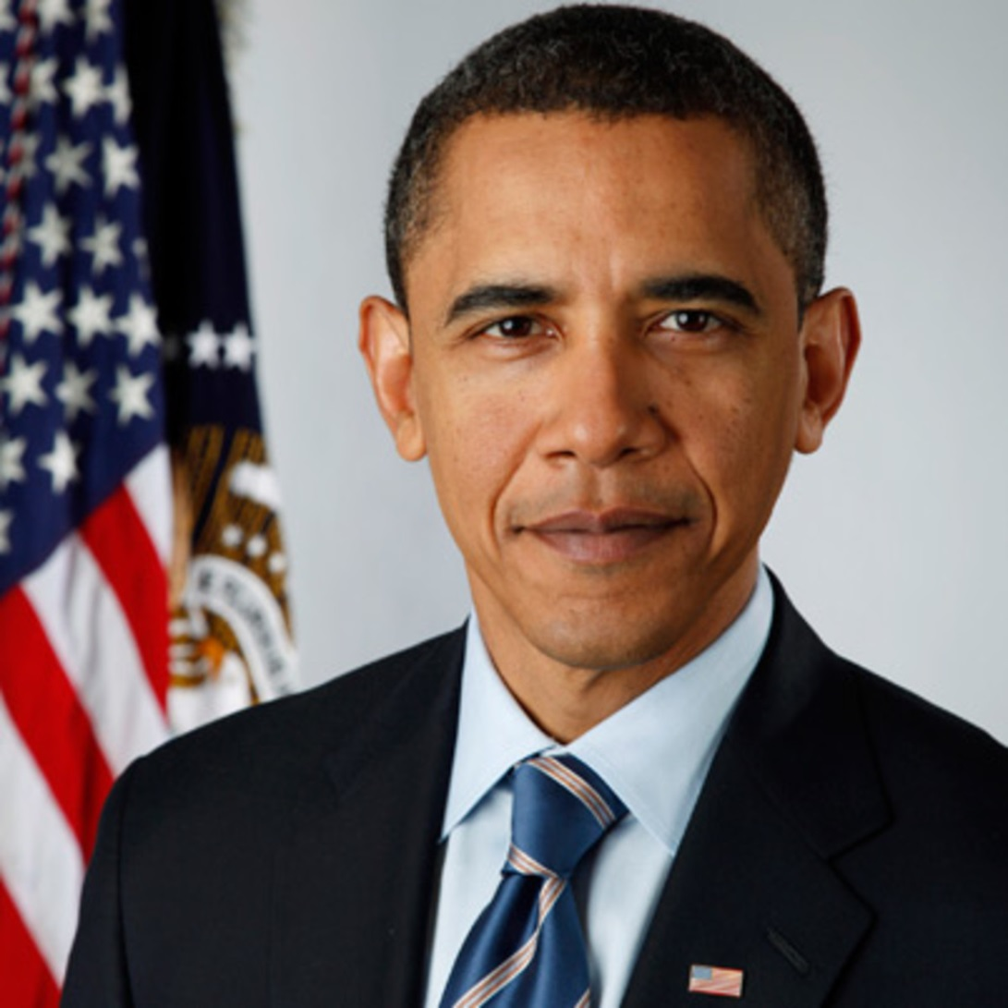
Manager or Leader
Barack Obama

Slide 6

Manager or Leader
Steve Jobs

Slide 7
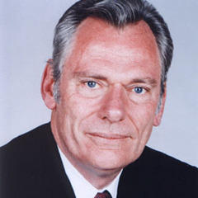
Manager or Leader
Herb Kelleher

Slide 8
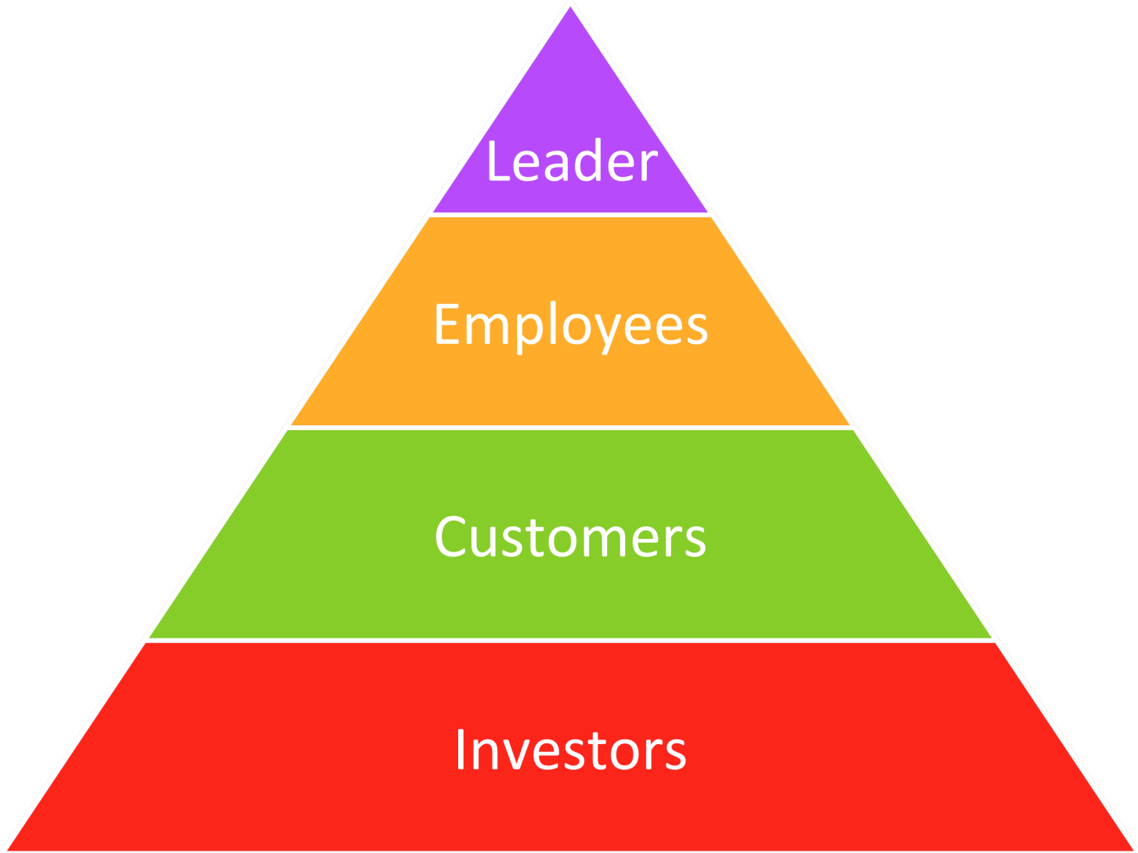
Typical Leadership Model

Slide 9
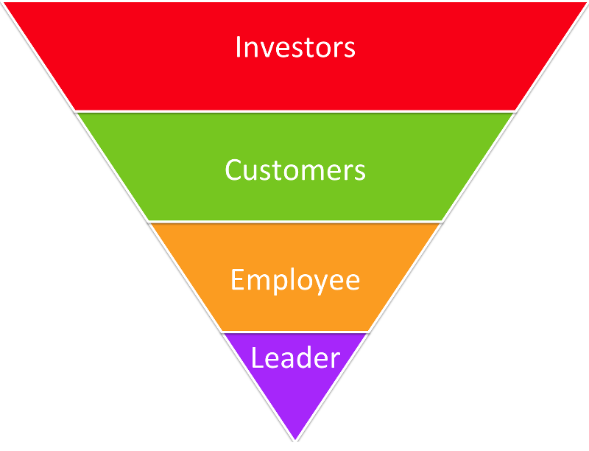
Servant Leadership Model

Slide 10
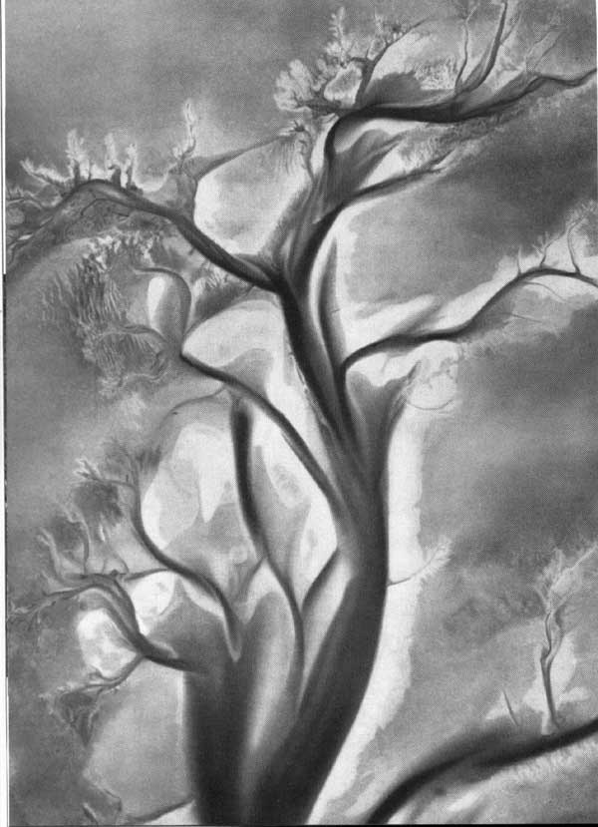
Tributary Leadership Model

Slide 11
Manager
Leader
Manages
Transactional
Drives
Controls
Produces
Leads
Transformational
Facilitates
Motivates
Envisions

Slide 12
Leadership Competence
Share your vision
Prioritize your plan
Delegate responsibility
Celebrate success

Slide 13
4 Keys to Being a Better Leader
Practice delegation
Explain the vision, follow up
Practice communication
Be clear and direct
Practice enthusiasm
Be positive, check your attitude
Practice accountability
Don’t make empty promises

Slide 14
Greatest Challenges
Not understanding the followers
Not focusing on the vision
Not clear about your role

Slide 15
Important Characteristics
Enthusiasm
Empathy
Encourages
Excellence

Slide 16
Trained or Born
Natural gifts
Leadership can be learned
Be approachable
Be a good follower

Slide 17
Future Consideration
“50% of the occupations that exist today will not exist 10 years from now.”
Liz Bentley Associates

Slide 18
Future Leadership Skills
Technology management
Comfortability embracing new technology
Out-centric leadership
People and team development
Soft skill assessment
Employee evaluation of soft skills to compliment technical skills
Rowe focus
Results-only work environments
Measure success on output not hours worked

Slide 19
Future Leadership Skills (cont’d)
Tension tolerant collaboration
Teamwork with appropriate level of constructive debate
Transparency
Build trusting relationships to retain quality team members
Emotional Intelligence
Empathy, perspective, and engagement with team members

Slide 20
Breakout Session
Designate a recorder
Designate a presenter
Discuss the questions
Presenter report to the entire class (under 5 minutes)
Recorder summarize discussion and turn in notes

Slide 21
Breakout Session (cont’d)
Read the scenario and consider the following:
What factors should you be considering?
Does this scenario require management or leadership emphasis? Why?
What are your immediate steps?
What are your future steps?
If you are not in an authority position, how would you change your approach?

Slide 22
Leadership Summary
Leadership and management are cooperative characteristics
Leadership requires practice
Leadership is critical – even if you are not an authority
Leadership is influence
Leadership is a moving target that needs continuous monitoring

Slide 23
Next Week: Communicating with Power
Effective communication
Generational communication
Adversarial communication
Clear and accountable communication

Slide 24
Leadership Reading List
The 21 Irrefutable Laws of Leadership by John Maxwell
The Art of Work by Jeff Goins
Failing Forward by John Maxwell
How to Lead, When You’re Not in Charge by Clay Scroggins
The Journey to Competitive Advantage Through Servant Leadership by Bill B. Flint Jr.
Lead Like Me by Geoff Loftus
Steve Jobs by Walter Isaacson
What the Most Successful People Do at Work by Laura Vanderkam

Slide 25
Leadership Articles and Blogs
“3 Principles of Tributary Leadership” by Sam Decker
“7 Skills Managers Will Need in 2025” by Gwen Moran
“The Effective Organization: Five Questions to Translate Leadership into Strong Management” by Kirk Kramer and Daniel Stid
“Management vs. Leadership” by Liz Ryan
“The Real Beauty In Leadership Happens by Going Above and Beyond” by Dan Pontefract
“The Roots of Becoming a More Effective Leader” by Dan Pontefract
“The Strength of a Leader Comes From the Tree Trunk” by Dan Pontefract

